Slide 1



Physical Education
Curriculum

Slide 2
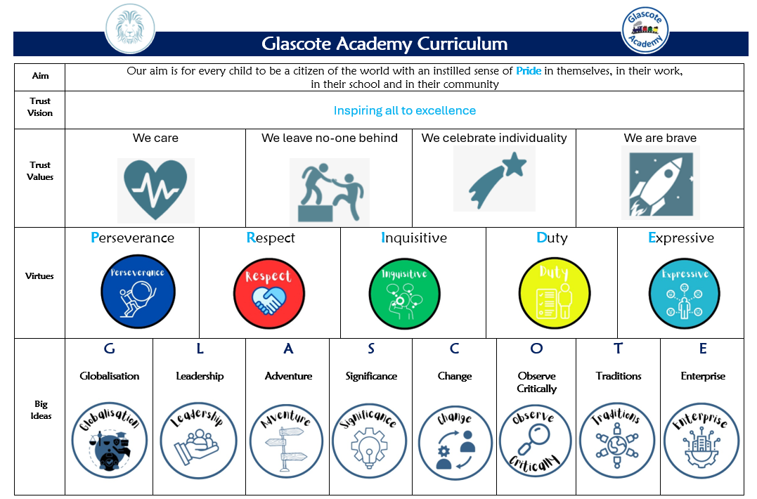
The Curriculum – Our approach

Slide 3


Curriculum Intent
Raises aspirations and open’s their eyes to a world beyond their immediate surroundings
Upholds and promotes our vision of “Pride”
Shapes independent and co-operative learners who learn from their mistakes
Promotes a life-long love of learning
We consider our Glascote Family to be special and unique and as such our pupils deserve a curriculum that…
Promotes practical everyday life skills that prepare them for their future
Promotes creativity, curiosity, and confidence
Secures knowledge and skills across all EYFS and National Curriculum subjects that build upon prior knowledge
Builds character, resilience, self-motivation, and a will to succeed

Slide 4


Subject Specific Sequencing and Key Concepts: Each subject has been planned to ensure that knowledge and skills are sequenced from Early Years to Year 6. Key Concepts are the subject specific ‘Golden Threads’ that children will learn about, return to and revisit as they progress through our school. Our pupils will have opportunities to link new learning to prior knowledge thus building a rich and deep knowledge of these ‘Golden Threads’ with each encounter. (See Physical Education long term plan with key concepts)
Big Ideas:
These are the overarching ‘Glascote’ concepts that pupils can use and apply across different curriculum subjects. For example, in all areas of the curriculum, children will build an understanding of ‘significance’; learning about significant authors, artists, scientific discoveries, pieces of music, figures and events from different cultures, religions and history.
Character Virtues:
These are the underpinning qualities and character traits stemming from ‘Pride’ that we desire all of our children, and staff, to demonstrate.

Slide 5




IMPLEMENTATION – Our approach
We use “imoves” to deliver our curriculum which encompasses all areas of physical activity including fundamentals, dance, gymnastics, football, basketball. Our chosen sports and units of study at Glascote Academy:
provide opportunities for the learning and development of a range of skills through a wide and varied selection of sports
Provide opportunities to play competitive games or perform (dance and gymnastics) and the end of each unit.
During lessons, our children will:
Learn new skills
Enjoy being active
Practice and master their skills
Observe
Listen
Discuss tactics
Self and peer assess

Slide 6
IMPLEMENTATION – Our approach
The sequential progression of substantive knowledge and disciplinary skills are set out to to ensure that all pupils:
develop competence to excel in a broad range of physical activities​
are physically active for sustained periods of time​
engage in competitive sports and activities ​
lead healthy, active lives.
Staff at Glascote Academy create a positive attitude towards PE learning both inside and outside the classrooms and promote the expectation that all children can achieve highly through adaptive teaching. Recall, repetition, modelling and practice are key facilitators used to support all children in their learning. Key vocabulary is an integral part of each unit of work, enabling children to have a greater understanding of important key concepts, ‘Golden Threads’, thus enabling them to communicate accurately about Physical Education.

Slide 7
EYFS
PSED​ Managing self:​ Be confident to try new activities and show independence, resilience and perseverance in the face of a challenge. ​ Explain the reasons for rules, know right from wrong and try to behave accordingly. ​ Manage their own basic hygiene and personal needs, including dressing. ​ Building Relationships:​ Work and play cooperatively and take turns with others.​ PD​ Negotiate space and obstacles safely, with consideration for themselves and others. ​ Demonstrate strength, balance and coordination when playing. ​ Move energetically, such as running, jumping, dancing, hopping, skipping and climbing. ​ EAD​ Perform songs, rhymes, poems and stories with others, and (when appropriate) try to move in time with music
Key Stage National Curriculum Expectations: PE
Key stage 1: Pupils should develop fundamental movement skills, become increasingly competent and confident and access a broad range of opportunities to extend their agility, balance and coordination, individually and with others. They should be able to engage in competitive (both against self and against others) and co-operative physical activities, in a range of increasingly challenging situations. ​ Pupils should be taught to: ​ master basic movements including running, jumping, throwing and catching, as well as developing balance, agility and co-ordination, and begin to apply these in a range of activities ​ participate in team games, developing simple tactics for attacking and defending ​ perform dances using simple movement patterns. Key stage 2: Pupils should continue to apply and develop a broader range of skills, learning how to use them in different ways and to link them to make actions and sequences of movement. They should enjoy communicating, collaborating and competing with each other. They should develop an understanding of how to improve in different physical activities and sports and learn how to evaluate and recognise their own success. ​ Pupils should be taught to: ​ use running, jumping, throwing and catching in isolation and in combination ​ play competitive games, modified where appropriate [for example, badminton, basketball, cricket, football, hockey, netball, rounders and tennis], and apply basic principles suitable for attacking and defending​ develop flexibility, strength, technique, control and balance [for example, through athletics and gymnastics] ​ perform dances using a range of movement patterns ​ take part in outdoor and adventurous activity challenges both individually and within a team ​ compare their performances with previous ones and demonstrate improvement to achieve their personal best

Slide 8
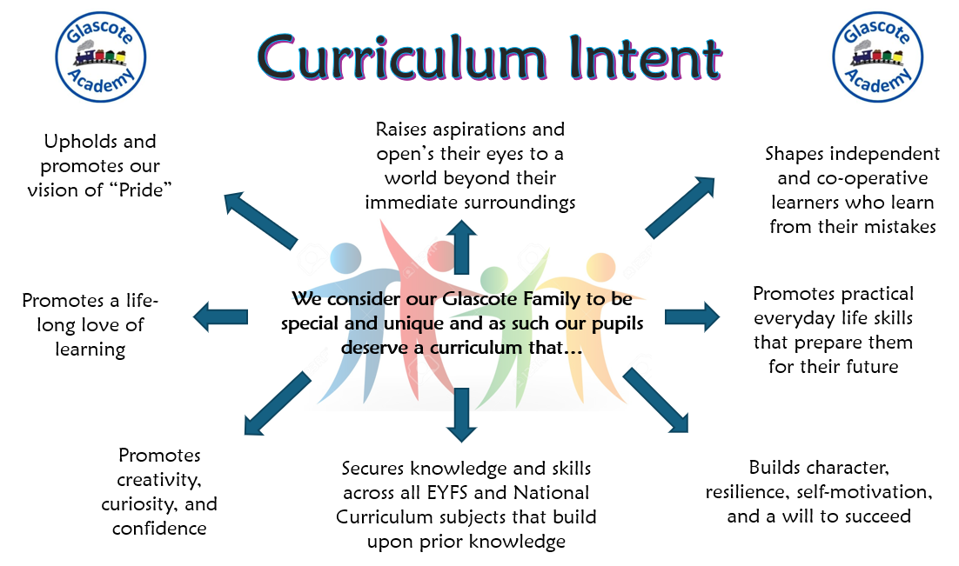
IMPACT– Our approach
At Glascote Academy, we are determined that teaching and learning in all subjects is driven by our curriculum intent. Therefore, we monitor the impact of learning in each lesson through teacher observations and discussions which is evidenced in displays, and Curriculum Power Points.
Impact is also measured at the end of a unit of work through:
the use of subject specific Assessment One Notes
Internal and external picture building

