Slide 1



MFL:
French
Curriculum

Slide 2
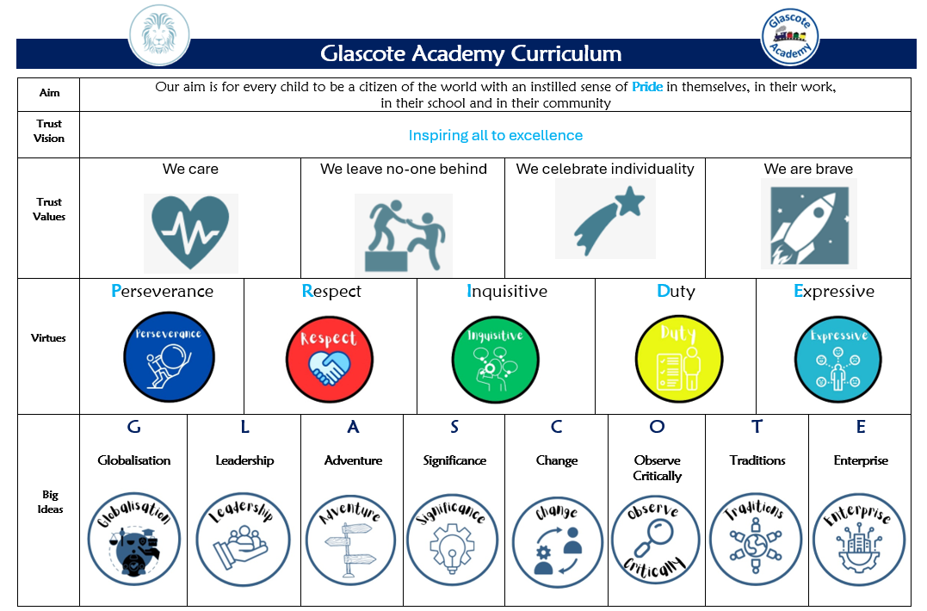
The Curriculum – Our approach

Slide 3


Curriculum Intent
Raises aspirations and open’s their eyes to a world beyond their immediate surroundings
Upholds and promotes our vision of “Pride”
Shapes independent and co-operative learners who learn from their mistakes
Promotes a life-long love of learning
We consider our Glascote Family to be special and unique and as such our pupils deserve a curriculum that…
Promotes practical everyday life skills that prepare them for their future
Promotes creativity, curiosity, and confidence
Secures knowledge and skills across all EYFS and National Curriculum subjects that build upon prior knowledge
Builds character, resilience, self-motivation, and a will to succeed

Slide 4
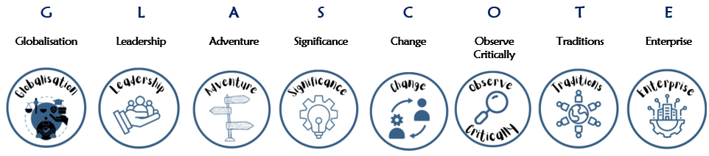

Subject Specific Sequencing and Key Concepts: Each subject has been planned to ensure that knowledge and skills are sequenced from Early Years to Year 6. Key Concepts are the subject specific ‘Golden Threads’ that children will learn about, return to and revisit as they progress through our school. Our pupils will have opportunities to link new learning to prior knowledge thus building a rich and deep knowledge of these ‘Golden Threads’ with each encounter. (See French long-term plan with key concepts)
Big Ideas:
These are the overarching ‘Glascote’ concepts that pupils can use and apply across different curriculum subjects. For example, in all areas of the curriculum, children will build an understanding of ‘significance’; learning about significant authors, artists, scientific discoveries, pieces of music, figures and events from different cultures, religions and history.
Character Virtues:
These are the underpinning qualities and character traits stemming from ‘Pride’ that we desire all of our children, and staff, to demonstrate.

Slide 5




IMPLEMENTATION – Our approach
At Glascote Academy, we chose to teach French to our children as it is the fifth most widely spoken language in the world with 300+ million people speaking French across the globe. French is also considered one of the most important languages in the international job market. Learning, reading, writing, and speaking a new language also helps with brain development, memory improvement, and retention.
French at Glascote Academy, was previously is taught by following the scheme of work from Twinkl; however, to ensure that our pupils have a secure knowledge of French phonics and grammar, we have moved to ‘Kapow’. Furthermore, we chose Kapow for our pupils as we believe that it supports our aim to build citizens of the world, our intrinsic values, virtues and ‘Big Ideas’.
Kapow’s French scheme of work aims to instil a love of language learning and an awareness of other cultures. We want pupils to develop the confidence to communicate in French for practical purposes, using both written and spoken French. Through this, we aim to give pupils a foundation for language learning that encourages and enables them to apply their skills to learning further languages, developing a strong understanding of the English language, facilitating future study and opening opportunities to study and work in other countries in the future.

Slide 6
IMPLEMENTATION – Our approach
The French curriculum is designed with three knowledge strands that run throughout our units with knowledge building cumulatively. These are:
● Phonics
● Vocabulary
● Grammar
This knowledge can then be applied within the skills strands, which also run throughout each unit in the curriculum:
● Language comprehension (Listening and reading)
● Language production (Speaking and writing).
Through the French curriculum, pupils are given opportunities to communicate for practical purposes around familiar subjects and routines
Through a spiral curriculum, key skills and vocabulary are revisited repeatedly with increasing complexity, allowing pupils to revise and build on their previous learning.
Staff at Glascote Academy create a positive attitude towards French learning both inside and outside the classrooms and promote the expectation that all children can achieve highly through adaptive teaching. Recall, repetition, modelling and practice are key facilitators used to support all children in their learning. Key vocabulary is an integral part of each unit of work, enabling children to have a greater understanding of important key concepts, ‘Golden Threads’, thus enabling them to communicate effectively in another language.

Slide 7
Key Stage National Curriculum Expectations: French
Key stage 2: Pupils should be taught to: listen attentively to spoken language and show understanding by joining in and responding explore the patterns and sounds of language through songs and rhymes and link the spelling, sound and meaning of words engage in conversations; ask and answer questions; express opinions and respond to those of others; seek clarification and help speak in sentences, using familiar vocabulary, phrases and basic language structures develop accurate pronunciation and intonation so that others understand when they are reading aloud or using familiar words and phrases present ideas and information orally to a range of audiences read carefully and show understanding of words, phrases and simple writing appreciate stories, songs, poems and rhymes in the language broaden their vocabulary and develop their ability to understand new words that are introduced into familiar written material, including through using a dictionary write phrases from memory, and adapt these to create new sentences, to express ideas clearly describe people, places, things and actions orally and in writing understand basic grammar appropriate to the language being studied, including (where relevant): feminine, masculine and neuter forms and the conjugation of high-frequency verbs; key features and patterns of the language; how to apply these, for instance, to build sentences; and how these differ from or are similar to English

Slide 8
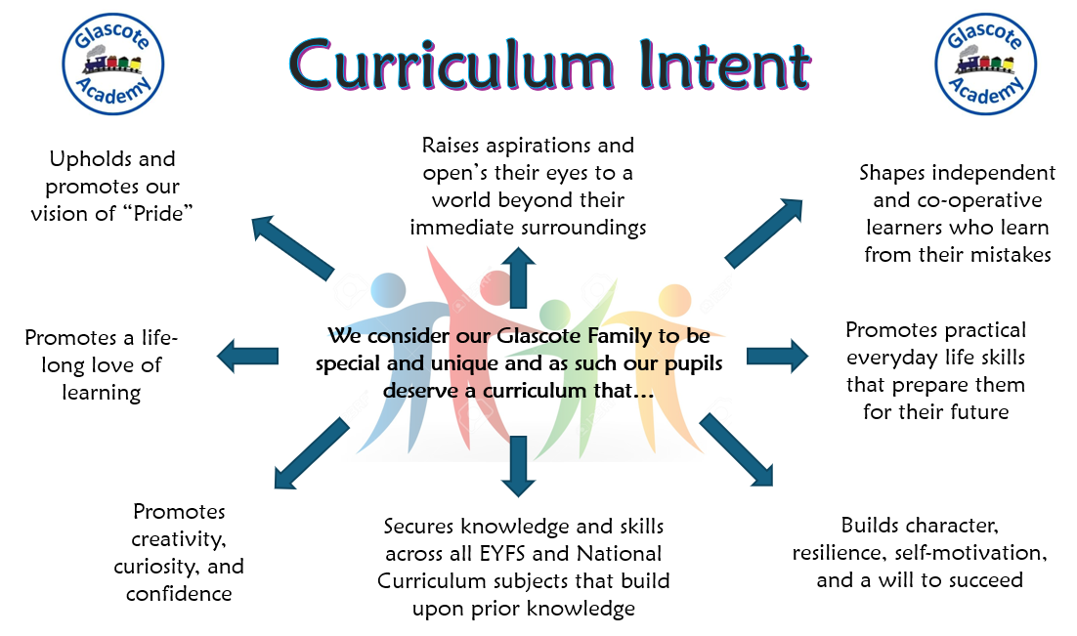
IMPACT– Our approach
At Glascote Academy, we are determined that teaching and learning in all subjects is driven by our curriculum intent. Therefore, we monitor the impact of learning in each lesson through teacher observations, children’s verbal and written responses, discussions, low-stake quizzes and work produced which is evidenced in children’s books, displays, and Curriculum Power Points.
Impact is also measured at the end of a unit of work through:
the use of subject specific Assessment One Notes
Internal and external picture building

